Slide 1
Binary Search Tree

Slide 2
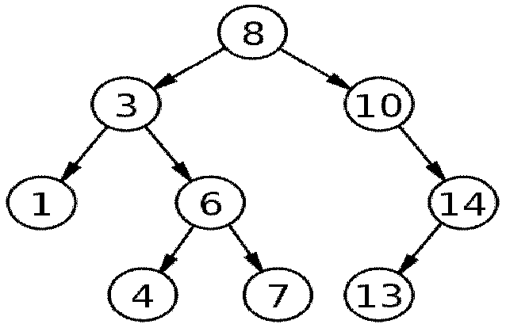
Binary Search Tree
A binary search tree (BST) is a node-based binary tree data structure which has the following properties:
The left subtree of a node contains only nodes with keys less than the node’s key.
The right subtree of a node contains only nodes with keys greater than or equal to the node's key.
Both the left and right subtrees must also be binary search trees.

Slide 3
Binary Search Tree
Firstly, it is a binary tree
It is represented by a linked data structure
It combines
the advantage of an array -- the ability to do a binary search with
the advantage of a linked list -- its dynamic size
The efficiency of all of the operations is O(h) = O(log n), only if the tree is reasonably height-balanced
Each node contains at least the following fields
key: an identifying field
left: pointer to a left child (may be NIL)
right: pointer to a right child (may be NIL)
p: pointer to the parent node (NIL for root)

Slide 4
Binary Search Tree
Secondly, the binary-search-tree property
For any node x,
key [y] < key [x]
key [y] ≥ key [x]
if y in left subtree of x
if y in right subtree of x

Slide 5
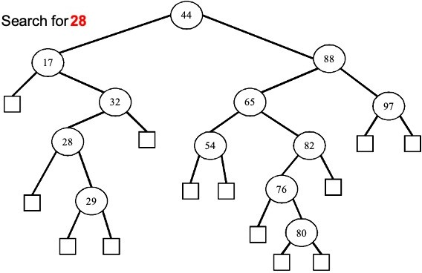
Operation on BST: Search

Slide 6
Operation on BST: Search
Compare with root

Slide 7
Operation on BST: Search
Compare with node

Slide 8
Operation on BST: Search
Compare with node

Slide 9
Operation on BST: Search
Found!!

Slide 10
Operation on BST: Search
Given a key k and a pointer to the root, Tree-Search returns a pointer to a node with key k
or NIL:
Tree-Search(x, k)
//return if found
if(x == NIL or k==key[x])
return x;
//else recursively search in subtree
if(k < key[x])
return Tree-Search(left[x], k);
else return Tree-Search(right[x], k);

Slide 11
Operation on BST: Search
Here is another function that does the same:
Tree-Search(x, k)
while (x != NIL and k != key[x]){
if (k < x->value)
x = x->left;
else
x = x->right;
}
return x;

Slide 12
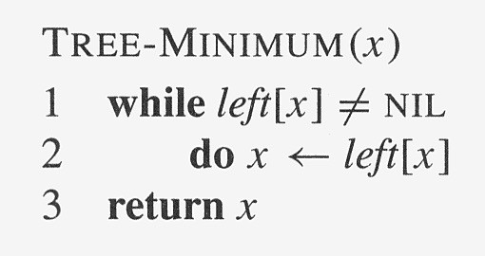
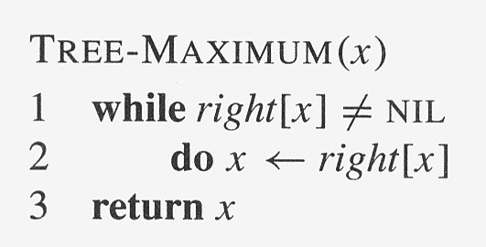
Operation on BST: Min & Max

Slide 13
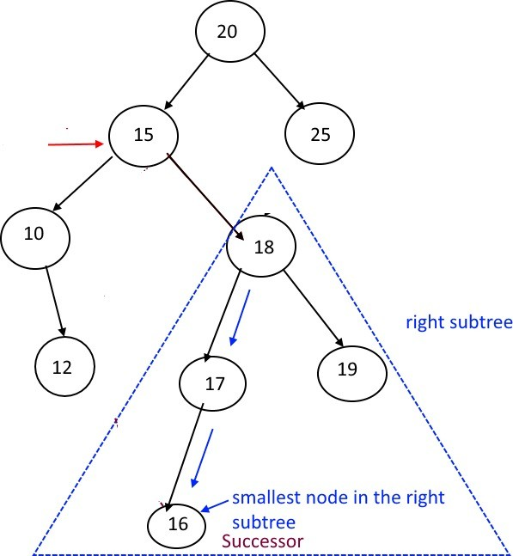
Operation on BST: Successor
Two cases:
Case 1: x has a right subtree:
successor is minimum node in right subtree

Slide 14
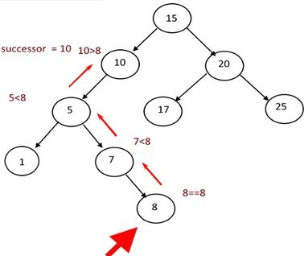
Operation on BST: Successor
Two cases:
Case 2: x has no right subtree:
successor is first ancestor of x whose left child is also ancestor of x
Intuition: As long as you move to the left up the tree, you’re visiting smaller nodes.

Slide 15
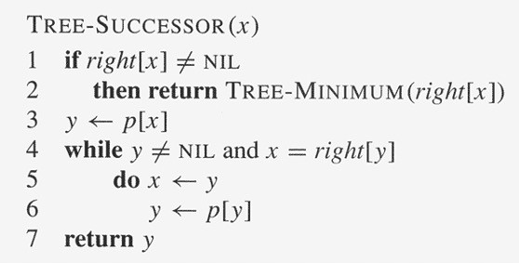
Operation on BST: Successor (Code)
TREE-SUCCESSOR(x) //pseudocode
if x->right != NULL
find minimum node of right sub tree
else
find y such that y is x->ancestor and y->left is x->ancestor
y is the 1st node with this property

Slide 16
Operation on BST: Predeccessor
Two cases:
similar to Successor algorithm
Maximum node in the left sub tree
TREE-PREDECESSOR(x) //pseudocode
if x->left != NULL
find maximum node of left sub tree
else
find y such that y is x->ancestor and y->right is x->ancestor
y is the 1st node with this property

Slide 17
Operation on BST: Insert
Inserts an element z to the tree so that the binary search tree property continues to hold
The basic algorithm
Like the search procedure as discussed before
Insert z in place of NIL
Use a “trailing pointer” to keep track of where you came from (like inserting into singly linked list)

Slide 18
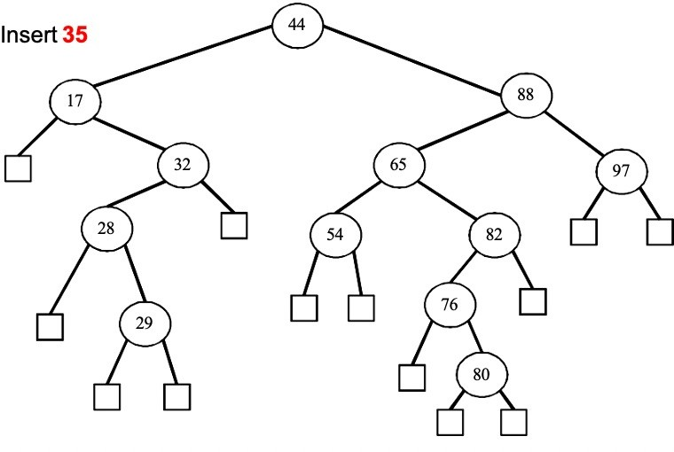
Operation on BST: Insert

Slide 19
Operation on BST: Insert
Compare with root
shoumik@cse.uiu.ac.bd

Slide 20
Operation on BST: Insert
Compare with node

Slide 21
Operation on BST: Insert
Compare with node

Slide 22
Operation on BST: Insert
External node

Slide 23
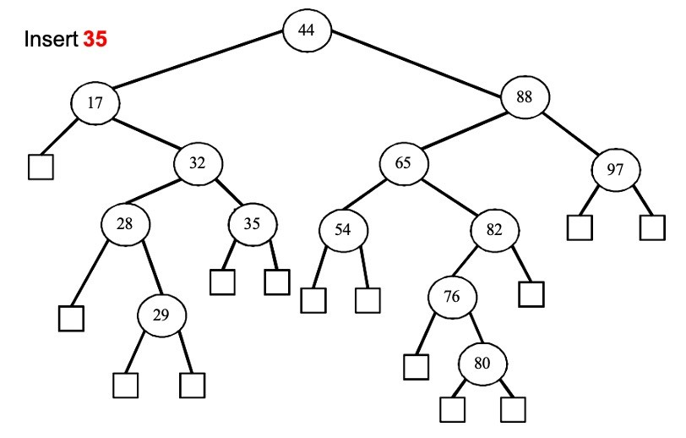
Operation on BST: Insert
External node

Slide 24
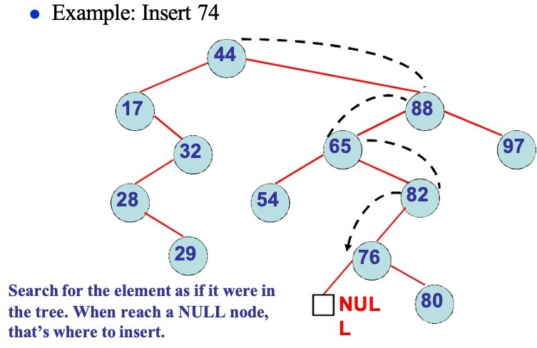
Operation on BST: Insert

Slide 25
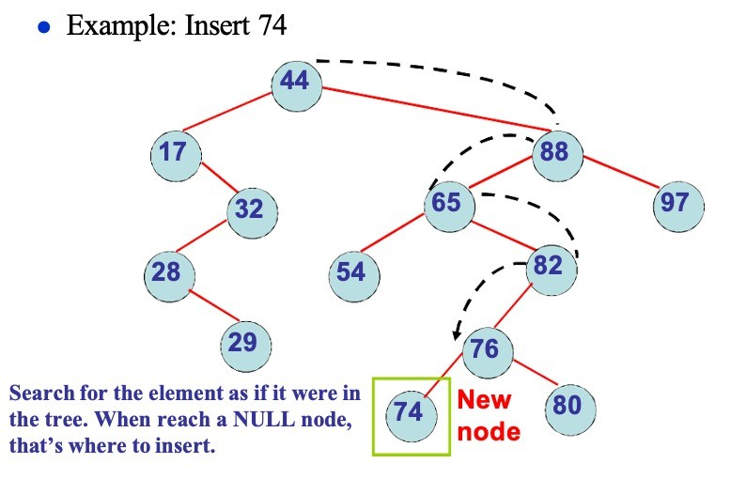
Operation on BST: Insert

Slide 26
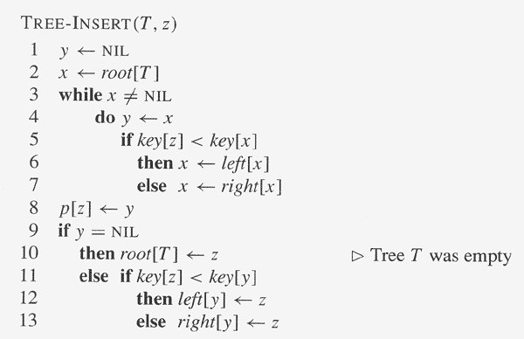
Operation on BST: Insert

Slide 27
Operation on BST: Insert
Draw a Binary Search Tree (showing each step) after inserting the following keys:
22, 15, 25, 10, 35, 46, 37, 8, 50

Slide 28
Operation on BST: Delete
Delete node x
3 cases:
x has no children:
Remove x
x has one child:
Splice out x
x has two children:
Find its inorder successor y
Replace x with y
Delete y

Slide 29
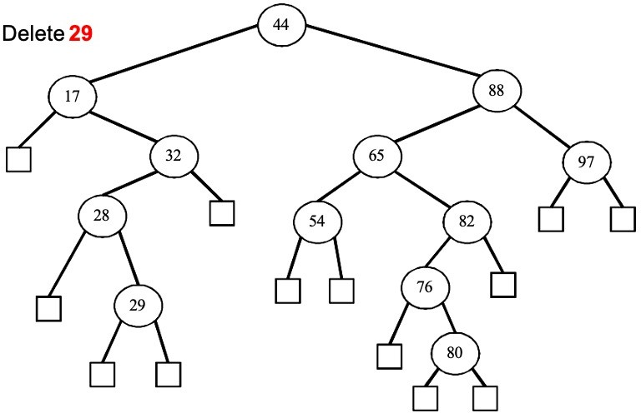
Operation on BST: Delete

Slide 30
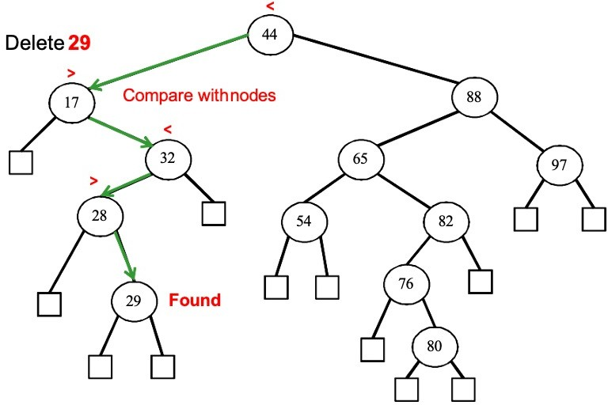
Operation on BST: Delete

Slide 31
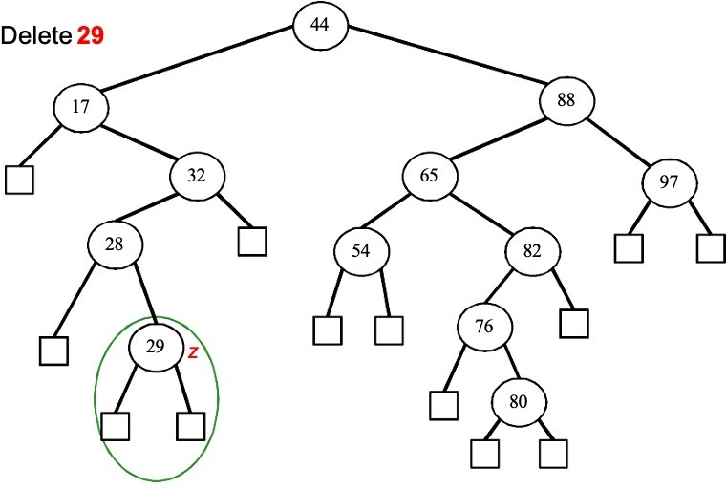
Operation on BST: Delete

Slide 32
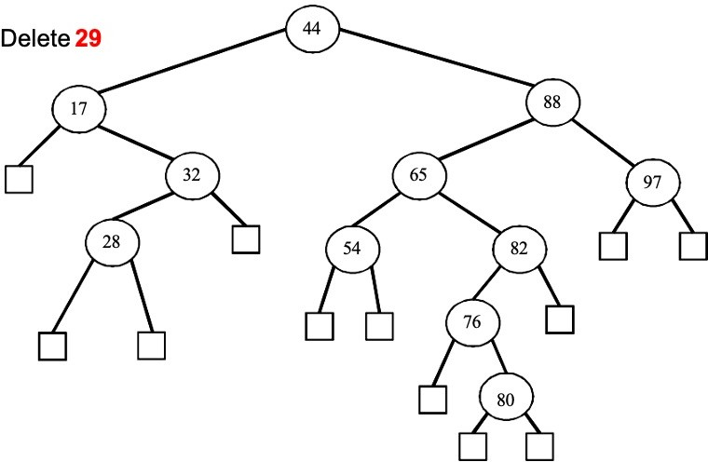
Operation on BST: Delete

Slide 33
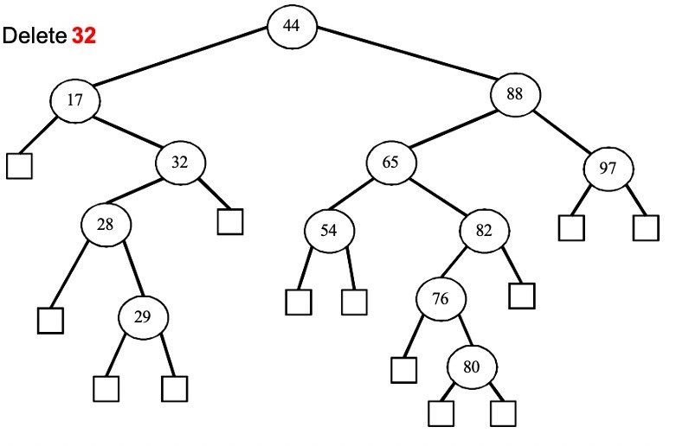
Operation on BST: Delete

Slide 34
Operation on BST: Delete
Found!

Slide 35
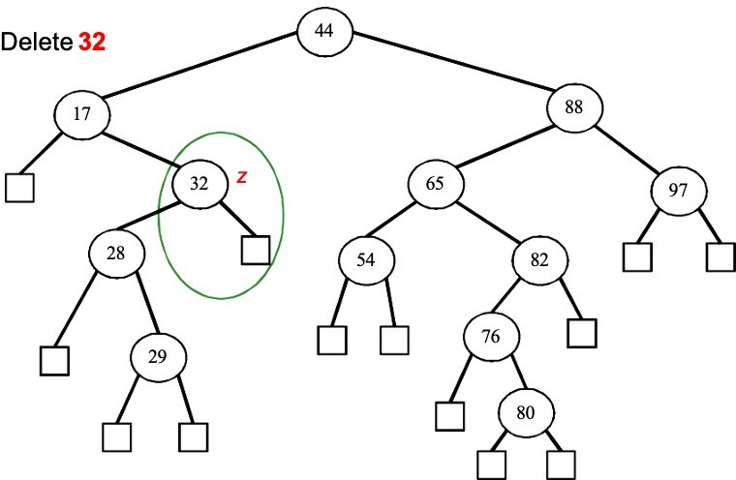
Operation on BST: Delete
Splice out z

Slide 36
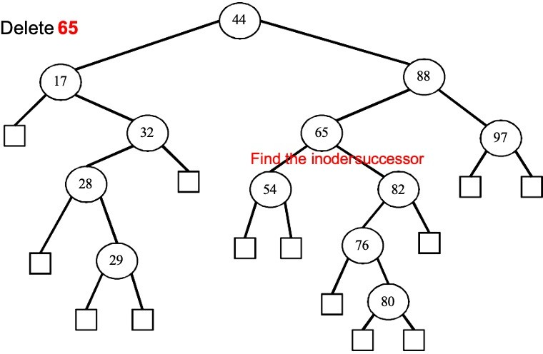
Operation on BST: Delete

Slide 37
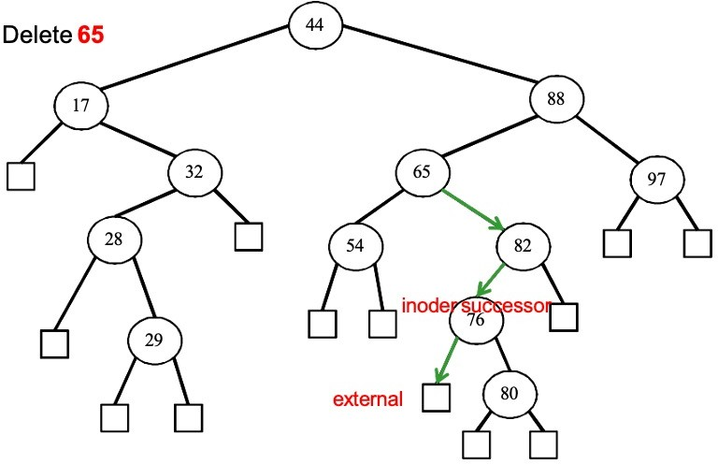
Operation on BST: Delete

Slide 38
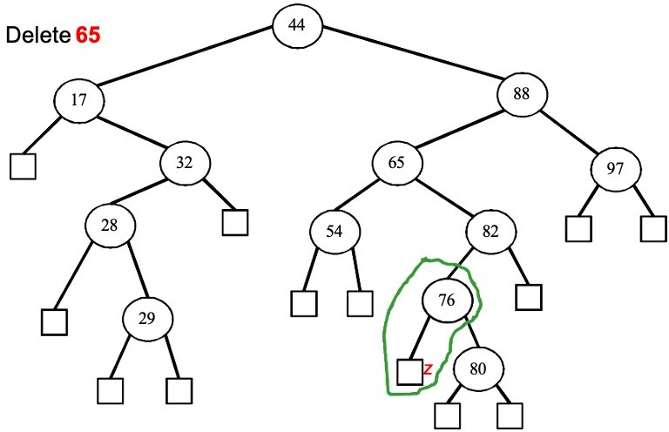
Operation on BST: Delete

Slide 39
Operation on BST: Delete

Slide 40
Operation on BST: Simulation
Draw the BST after doing each step of the following statements:
Insert 85
Delete 28
Delete 76
Insert 55
Delete 44

Slide 41
Sorting with BST
Informal code for sorting array A of length n:
BSTSort(A)
for i=1 to n
TreeInsert(A[i]);
InorderTreeWalk(root);
Running time is O(n lg n)
What will be the running time in the
Worst case?
Average case?

Slide 42
BST: Remarks
All complexity depends on height h
h = O(lg n)
To guarantee performance:
Balanced tree !
Randomly build tree
Theorem: The expected height of a randomly built binary search tree on n distinct keys is
O (lg n)

Slide 43
Balanced BST
Keep O(lg n) height under dynamic operations
General framework:
First a binary search tree
Maintain properties that ensure height guarantee
AVL tree, red-black tree, …

Slide 44
Codes for BST
#include<stdio.h> #include<stdlib.h>
typedef struct BSTnode{
int key;
struct BSTnode *left;
struct BSTnode *right;
} BSTnode;
BSTnode *create( ){
BSTnode *temp;
printf("\nEnter key: ");
temp = (BSTnode*)malloc(sizeof(BSTnode));
scanf("%d", &temp->key);
temp->left = temp->right = NULL;
return temp;
}

Slide 45
Codes for BST
void insert(BSTnode *root, BSTnode *temp){ if(temp->key < root->key){
if(root->left != NULL)
insert(root->left, temp);
else
root->left = temp;
}
if(temp->key > root->key){
if(root->right != NULL)
insert(root->right, temp);
else
root->right = temp;
}
}
BSTnode *minValueNode(BSTnode *node){
BSTnode *current = node;
while (current->left!=NULL) current = current->left;
return current;
}

Slide 46
BST Deletion
node* BSTDeletion(node * root, int key){
node* current = root;
node* parent = nullptr;
// Search for the node to be BSTDeletiond and its parent
while (current != nullptr && current->data != key) {
parent = current;
if (key < current->data)
current = current->left;
else
current = current->right;
}
//current holds the node to be deleted
// If the key is not found, return the original root
if (current == nullptr) return root;

Slide 47
BST Deletion(continued)
//case-1: Node with no left child or no child
if (current->left == nullptr) {
if (parent == nullptr) {
root = current->right;
} else if (parent->left == current) {
parent->left = current->right;
} else {
parent->right = current->right;
}
free(current);
}

Slide 48
BST Deletion(continued)
//case-2: node having no right child
else if (current->right == nullptr) {
if (parent == nullptr) {
root = current->left;
} else if (parent->left == current) {
parent->left = current->left;
} else {
parent->right = current->left;
}
free(current);
}

Slide 49
BST Deletion(continued)
else {
// Node with two children: Get the inorder successor
node* successor = current->right;
node *succParent = current;
while(successor->left!=NULL)
successor=successor->left;
// Copy the inorder successor's data
current->data = successor->data;
// BSTDeletion the inorder successor
current->right = BSTDeletion(current->right,successor->data);
}
return root;
}

Slide 50
Codes for BST
BSTnode* deleteNode(BSTnode *root, int key){
if (root == NULL) return root;
// If the key to be deleted is smaller than the root's key, then it lies in left subtree
if (key < root->key)
root->left = deleteNode(root->left, key);
// If the key to be deleted is greater than the root's key, then it lies in right subtree
else if (key > root->key)
root->right = deleteNode(root->right, key);
// if key is same as root's key, then This is the node to be deleted
else {
// node with only one child or no child
if (root->left == NULL) {
BSTnode *temp = root->right;
free(root);
return temp;
}
else if (root->right == NULL) {
BSTnode *temp = root->left;
free(root);
return temp;}

Slide 51
Codes for BST
// node with two children: Get the inorder successor (smallest in the right subtree)
BSTnode *temp = minValueNode(root->right);
// Copy the inorder successor's content to this node
root->key = temp->key;
// Delete the inorder successor
root->right = deleteNode(root->right, temp->key);
}
return root;
}
void inorder(BSTnode *root){ if(root != NULL) {
inorder(root->left);
printf("%d ", root->key); inorder(root->right);
}
}

Slide 52
Codes for BST
int main() {
char ch; int item;
BSTnode *root = NULL, *temp;
do {
temp = create(); if(root == NULL)
root = temp; else
insert(root, temp);
printf("\n Do you want to enter more(y/n)? ");
} while(ch=='y'|ch=='Y');
printf("\n Inorder traversal of the tree:\t"); inorder(root);
do {
if(root == NULL){
printf("\n No key to delete!"); return 0; } else {
getchar();
scanf(“%c”, &ch);
printf("\nDelete what? "); scanf("%d", &item); root = deleteNode(root, item);
printf("\nInorder traversal of the modified tree \t"); inorder(root);
}
printf("\nDo you want to delete more(y/n)? ");
} while(ch=='y'|ch=='Y'); return 0; }
re9/t2u1rn 0; }
getchar(); scanf(“%c”, &ch);
48

Slide 53
Thank You

